Slide 1
Welcome to My Presentation

Slide 2
A report on my financial Co. Walton Electronics Gazipur

Slide 3



Slide 4
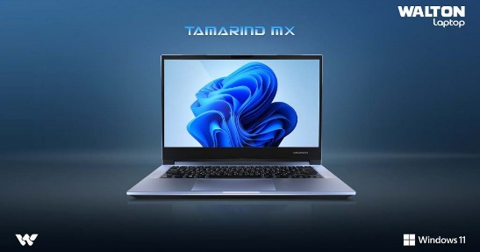
Laptops Walton laptops are highly regarded for their blend of performance, portability, and affordability.

Slide 5

Desktops Walton desktops are synonymous with power and dependability

Slide 6

Tablets Walton tablets are celebrated for their versatility and innovative features

Slide 7

Smartphones Walton smartphones enjoy a stellar reputation for advanced features, including high-resolution cameras, fast processors, and 5G capabilities.

Slide 8


Slide 9
Flow Chart of Business Plan
Walton Electronics
Sales Strategy
Distribution and Logistics
Customer Service
Financial Planning
Market Research
Product Development
Production Planning
Marketing Strategy
Monitoring and Evaluation

Slide 10
Statistics of sold products in the last 3 months
( January – March 2024)
The sum of Total Sales (BDT)
Product | Total
Desktop | 10000000
Laptop | 12500000
Smartphone | 6150000
Tablet | 3000000
Grand Total | 31650000

Slide 11
Sales Report of Walton Electronic of the Month January – March 2024
The sum of Total Sales (BDT)
Months (Date) | Total
Jan | 10000000
Feb | 35000000
Mar | 37500000
Grand Total | 82500000

Slide 12
Yearly report of Walton Electronics
Yearly report
Month | Expenses | Sales | Profit
January | 9288500 | 8750000 | -538500
February | 9744300 | 9920000 | 175700
March | 8904700 | 10000000 | 1095300
April | 7345200 | 7957400 | 612200
May | 8987000 | 9876500 | 889500
June | 5215400 | 5164500 | -50900
July | 9976500 | 11543600 | 1567100
August | 7976700 | 8087900 | 111200
September | 9879000 | 9969800 | 90800
October | 6234800 | 7024000 | 789200
November | 4534800 | 4809300 | 274500
December | 8348700 | 8834800 | 486100

Slide 13
Yearly report of Walton Electronics

Slide 14
Thank you

